Slide 1
Customer Attrition Data Analysis
LAKME Unisex Salon
Done by
Keerthana Kalaivanan – 100837032
Abraham Mathew – 100829875
Mathew Coe -100542534
Notes:
-

Slide 2
Agenda
Industry & Client Overview
Challenges & Scope
Project Journey
Data Exploration & Data Preparation
RFM & CLV
Survival Analysis
Outcomes & Findings
Recommendations

Slide 3
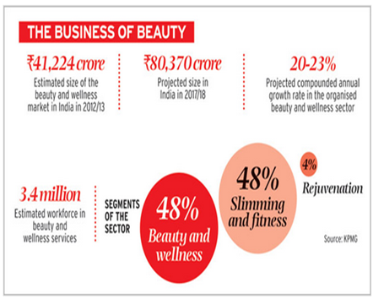
Industry Overview
India’s organised salon market is at 25%
Increased urbanization and rising disposable incomes
Increasing awareness of grooming among men
Availability of world class brands & products.

Slide 4
Client Overview
A leading Unisex Hair & Style Salon offering a full range of grooming solutions
275 active outlets - predominantly in south of India
Franchisee model - Stylists are directly trained and employed by the client
A separate luxury offshoot to cater to niche customers
Our client Lakme is a leading Unisex Hair & Style Salon offering a full range of grooming solutions (hair, body, and skin) for value conscious consumers They have currently 275 stores across India. While the stylists are employees, their branches are primarily franchises. They also have a luxury offshoot to cater to niche (rich) customers.

Slide 5
Objective & Scope
Capstone Objective
The CEO and CFO of the Group of Salons shared their concerns about customer attrition and the need for predicting attrition levels. The client wanted the capstone team to identify Customer Churn cycles and implement strategies that would improve customer retention and provide enhanced customer experience.
The following were agreed as Deliverables or scope of the project
Final Project Deliverable
Customer Segmentation: Analyse and Identify the different customer segments of our client. Customer Segmentation will enable us to identify a customer’s value with the salon and market suitable beauty solution to them
Build Prediction Model: Build a model to predict client churn. This churn model will give us a value which is the maximum number of days between two visits of a client, after which they will be considered as a customer attrition

Slide 6

Project Journey
RFM ANALYSIS
CLV CALCULATION
CLIENT MASTER
MEMBERSHIP MASTER
DATA
EXPLORATION
DATA
PREPARATION
MODEL SELECTION & EVALUATION
OUTCOMES & INSIGHTS
RECOMMENDATIONS
TRANSACTION MASTER
TRANSACTION
SERVICE MASTER
SERVICE CODE MASTER

Slide 7
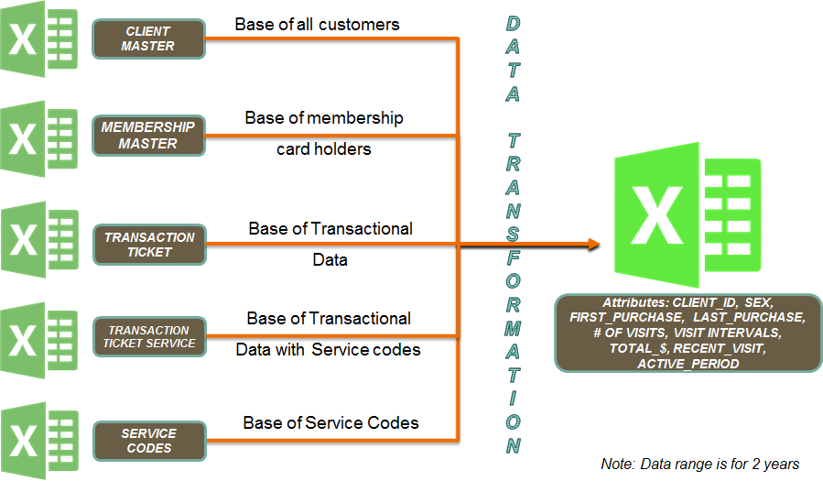
Creating The “Golden” Record - Data Exploration/Preparation
Illustration
Overview of Data
Insights
* General
* Churn related

Slide 8
Data Exploration
* Client Profiling
- Profile Clients on Transactions,Services, Gender and Membership Details
- 58% Male, 42% Female, 27 % Female Members, 38 % Male Members
* Quantitative Variables
- No of Client Transactions : 35367 (for both salons)
- Total Spend : INR 42 Million
* Qualitative Variables
- Salon Ids, Membership Details, Gender, Service Category
* Identify Key Business Elements for Churn
- Frequency of visits
- Last visit of the client
- Time interval between each visit

Slide 9
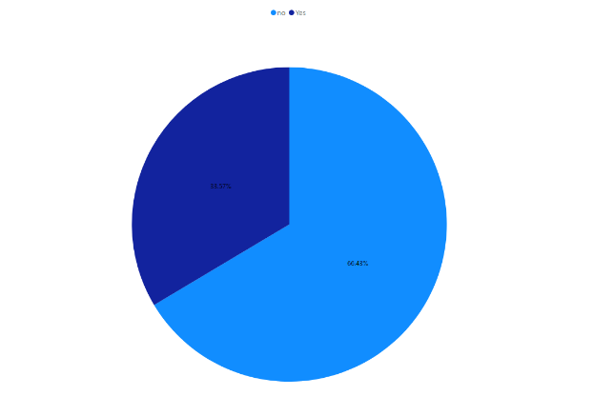
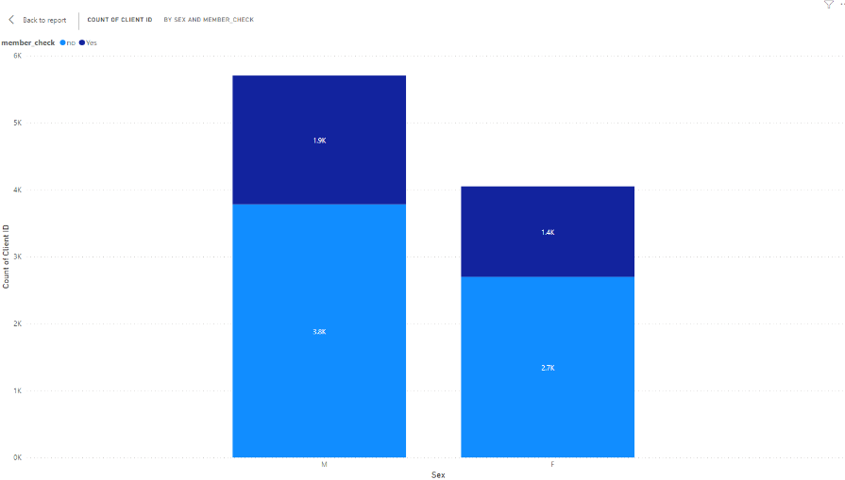
Visualization & Insights
Tool used: Power BI
Analysis by Gender – By Client Count and Membership
There are 66% non-members compared to 34% of membership holders
-By count, the number of Male customers is considerably high than female customers
-Also, there are much more male than female membership holder. Male numbers are almost high by 50%

Slide 10
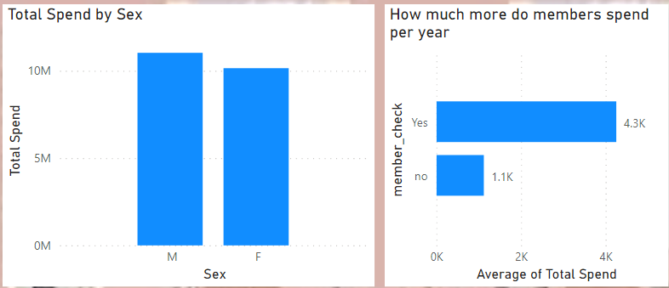
Visualization & Insights
Analysis of Spend by Sex and Membership
-Overall, we could see that Male clients spend more with the Salon than female clients
-Overall, we could see that membership holders spend more with the Salon than Non-Members

Slide 11
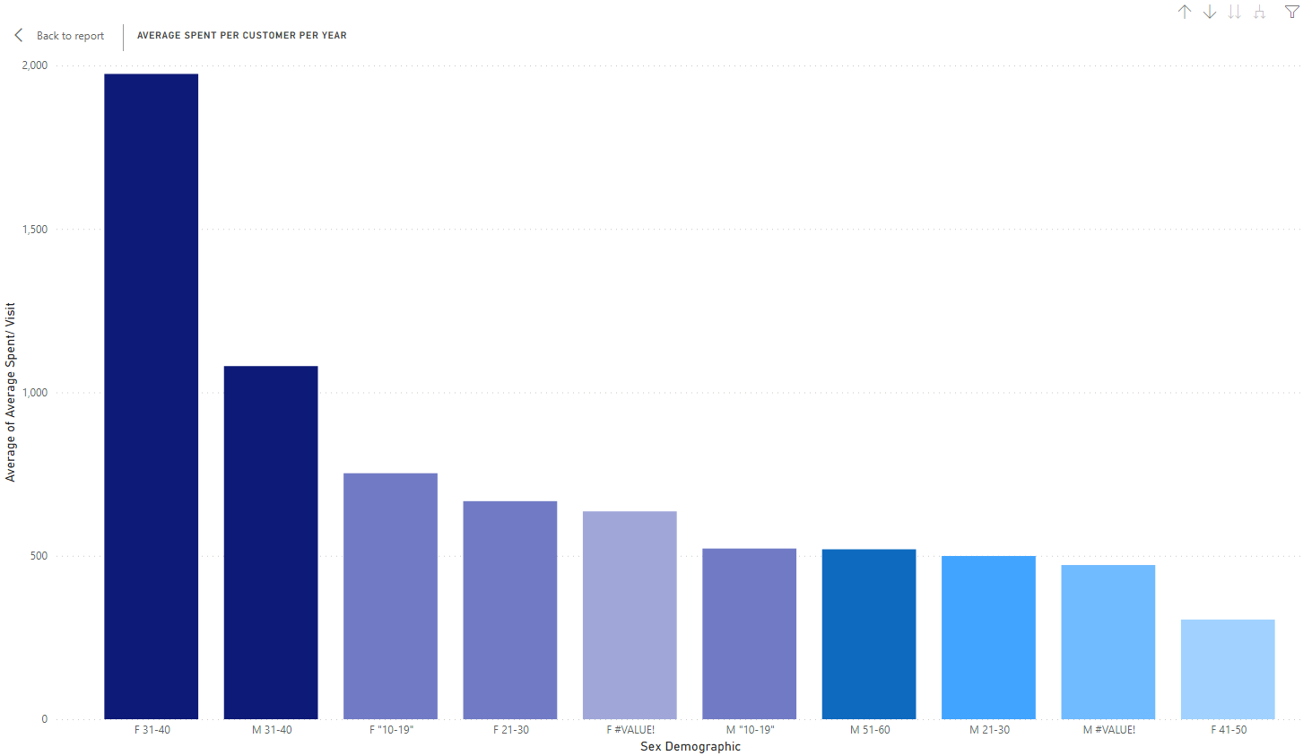
Visualization & Insights
Analysis of Average Spend by Sex and age group
-By sex and age group combination we could see that Females between the ages of 31 and 40 are the best group while female between 41-50 age group spends the lowest with the Salon.

Slide 12
Data Preparation
Steps
* Create “Customer Activity” Master Dataset
- Bring about a 360° view of client (Client and Transaction Data)
- Client level data : DOB, Client Name, Phone
- Transactional level data : Transaction Date, Transaction Amount
- Membership level data : Member Card No
- Service level data : Service Category
* Create derived values for identifying churn
- Frequency of customer visits
- Days difference between visits
Challenges
* Data anomalies with incorrect values for Client names and DOB
* Mismatch between Client and Membership data
* Inability to perform data imputation due to dependencies
Insights
* 40% of total visits are made by women
* 60% of total visits are made by men
* 8% of 9754 customers have high frequency
* 40% to 50% higher visits by men than women

Slide 13
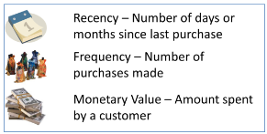
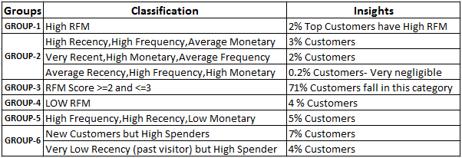
RFM - The Key Understanding to Customer Buying Behavior
1) Can you identify your best customers?
2) Do you know who your worst customers are?
3) Do you know which customers you just lost & which ones you’re about to lose?
4) Can you identify loyal customers who buy often, but spend very little?
5) Can you target customers who are willing to spend the most at your store?
Answers :
1) Yes, Best customers are 2% of the total clients
2) Yes, Worst customers are 4% of the total clients
3) Yes, 4% of the total customers fall in this category
4) Yes, 5% of the total customers fall in this category
5) Yes, 9.2% of the customers are willing to spend more in our salon

Slide 14


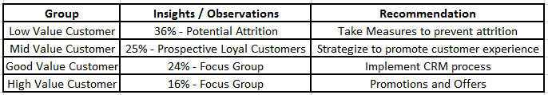
CLV - A Weighted RFM Approach to cater Customer Segmentation
Client Lifetime Value_{(Weighted RFM Model)}= (W_{Recency}* R-Score) + (W_{Frequency}* F-Score) + (W_{Monetary}* M-Score)
where W is the Weight Calculated through AHP(Analytic Hierarchical Process)
Insights through CLV:
Value Normalisation
Excel MMult() fn for vectors
Using Dr.Satty’s Scale

Slide 15
Model Selection
Our initial consideration was to evaluate Logistic regression and Survival analysis to predict the Attrition Cycles and Churn rate of our client’s customers.
Our client’s dataset has time to event data which depicts - Till what point in time the customer has been visiting our client - What was the last visited date/month/year?
Logistic Regression: Is used when the research objective is focused on whether an event occurred, rather than when it occurred i.e., time course information is not used. Instead of building a predictive model for “Y (Response)” directly, the approach models Log Odds (Y)
Survival Analysis: Survival Analysis is used to analyze the data in which the time until the event is of interest. The response is often referred to as survival time, failure time or event time.
On further discussion we are going forward with the Survival Analysis model since is Best Suited for our Client’s Customer Attrition Prediction since we need a period within which a customer doesn’t make a transaction with the client, he/she will be considered an attrition.

Slide 16
Survival Analysis
Overview
Collection of statistical methods to measure occurrence of events at various time intervals.
This model is developed based on two probability values namely, survival and hazard functions
Survival Function: Probability that the customer will survive even past time(t)
Harzard Function: Probability that the customer will not survive past time(t) or probability of churn, i.e., 1-Survival function
Methods to use in Survival Analysis
Kaplan-Meier Estimation allows estimation of survival over time, even when points drop out

Slide 17
Kaplan-Meier Estimation sample for 30 day period
Tool Used : R
Result
#
#read censored data ds = read.csv(file.choose(), header=TRUE) cdf = as.data.frame(ds) #install.packages("survival") library(survival)
#1000 samples, simple random sampling
detach(mini) mini= cdf[sample(nrow(cdf),1000, replace=FALSE, prob = NULL),] attach(mini)
#For 30 day study period churn = Churn_30 time = ActivePeriod
#response variable, referred as survival object response = Surv(time,churn) #Kaplain-Meier estimator with no covariates km.surv = survfit(response ~ 1,type="kaplan-meier",data=mini) summary(km.surv)
Call:
survfit(formula = response ~ 1, data = mini, type = "kaplan-meier") time n.risk n.event survival std.err lower 95% CI upper 95% CI 1 1000 542 0.458 0.0158 0.428 0.490 2 458 6 0.452 0.0157 0.422 0.484 3 452 1 0.451 0.0157 0.421 0.483 5 451 3 0.448 0.0157 0.418 0.480 6 448 2 0.446 0.0157 0.416 0.478 7 446 1 0.445 0.0157 0.415 0.477 8 445 3 0.442 0.0157 0.412 0.474 10 442 2 0.440 0.0157 0.410 0.472 11 440 1 0.439 0.0157 0.409 0.471 14 439 1 0.438 0.0157 0.408 0.470 15 438 1 0.437 0.0157 0.407 0.469 16 437 1 0.436 0.0157 0.406 0.468 18 436 4 0.432 0.0157 0.402 0.464 19 432 4 0.428 0.0156 0.398 0.460 21 428 3 0.425 0.0156 0.395 0.457 22 425 4 0.421 0.0156 0.391 0.453 23 421 2 0.419 0.0156 0.390 0.451 24 419 2 0.417 0.0156 0.388 0.449 25 417 1 0.416 0.0156 0.387 0.448 28 416 2 0.414 0.0156 0.385 0.446 29 414 1 0.413 0.0156 0.384 0.445

Slide 18
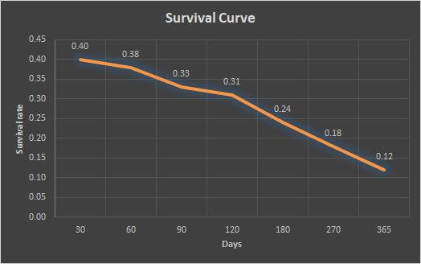
Survival Curve for one year period
Kaplan-Meier Estimates for study period of 30, 60, 90, 120, 180, 270 and 365 days were calculated and mapped in the chart. We could see that the curve looks flat between 60 and 120 days recency time period. This is the critical time period for the salon to concentrate on customers who does not visit again.
Insights
Customers with 60 days subscription are 38% likely to survive
Customers with 90 days subscription are 33% likely to survive

Slide 19
Outcomes & Findings
In 90 days,
Customers are seen to have survival value of 0.33 i.e., 33% less likely to churn
From the above statement, customers are seen to have hazard(churn) value of 0.77 i.e., 77% likely to churn
From the curve and further analysis of various time periods, we can conclude its imperative that the salon concentrates on people who does not visit in between 60–90-day period from their last visit

Slide 20

Recommendations
CUSTOMER RETENTION
* Catch them before they fall
62%-68% (M: 60%, F: 70%) churn happens within the 60–90-day period
- Outreach programs
- Offers for repeat services
* Out of mind = Out of business - patrons with large intervals between visits are 95% more likely to churn
- Promotion calls in right time interval
- Emails by educating the trending vogue and the
launch of new products & services

Slide 21
Recommendations
2.CUSTOMER EXPERIENCE
* Involve technology (Android apps etc) that can enable patrons to book appointments and know stylist availability etc.
* Show them you care - Create standardized and non-curated feedback channels for products and services offered
* Increase options- Options not only restricted to products and services but also in terms of stylist choices and can introduce a 5-point rating system to promote enthusiasm amongst patrons and stylists alike

Slide 22
Thank You

